Slide 1
LISTVIEW & GRIDVIEW
Giảng viên: Trương Thị Ngọc Phượng
Notes:
https://www.tutorialspoint.com/android/android_grid_view.htm
https://www.tutorialspoint.com/android/android_list_view.htm
https://www.raywenderlich.com/124438/android-listview-tutorial

Slide 2
content
What is ListView & GridView?
What is Adapter?
Listview Attributes
GridView Attributes
ArrayAdapter
SimpleCursorAdapter
ListView events
GridView events

Slide 3
content
What is ListView & GridView?
What is Adapter?
Listview Attributes
GridView Attributes
ArrayAdapter
SimpleCursorAdapter
ListView events
GridView events

Slide 4
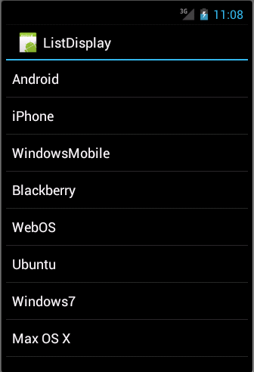
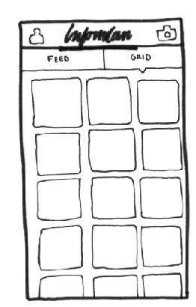
WHAT IS LISTVIEW & GRIDVIEW?
ListView is a view which groups several items and display them in vertical scrollable list.
GridView shows items in two - dimensional scrolling grid.

Slide 5
content
What is ListView & GridView?
What is Adapter?
Listview Attributes
GridView Attributes
ArrayAdapter
SimpleCursorAdapter
ListView events
GridView events

Slide 6
WHAT IS ADAPTER?
ListView & GridView are subclasses of AdapterView and they can be populated by binding them to an Adapter.
An adapter bridges between UI components and the data source that fill data into UI component.
Android provides several subclasses of Adapter: ArrayAdapter, BaseSimpleCursorAdapter, SpinnerAdapter, WrapListAdapter, etc.

Slide 7
content
What is ListView & GridView?
What is Adapter?
Listview Attributes
GridView Attributes
ArrayAdapter
SimpleCursorAdapter
ListView events
GridView events

Slide 8
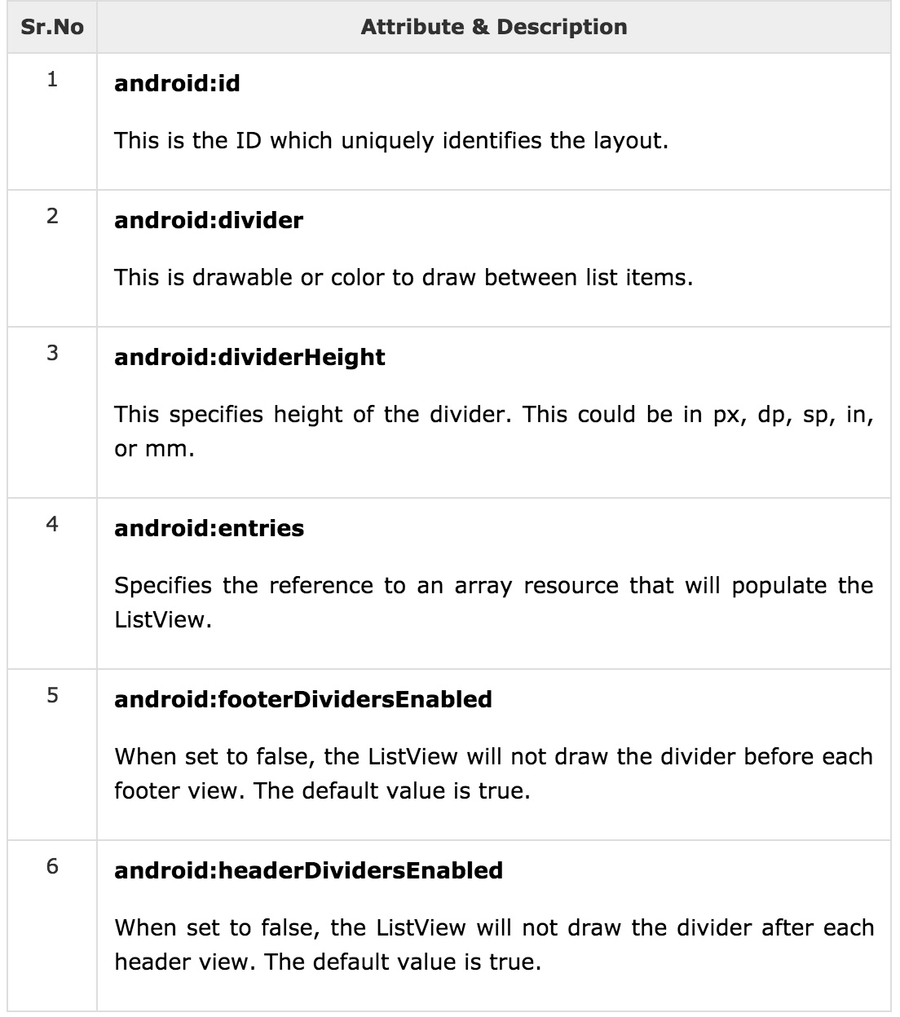
LISTVIEW ATTRIBUTES

Slide 9
content
What is ListView & GridView?
What is Adapter?
Listview Attributes
GridView Attributes
ArrayAdapter
SimpleCursorAdapter
ListView events
GridView events

Slide 10
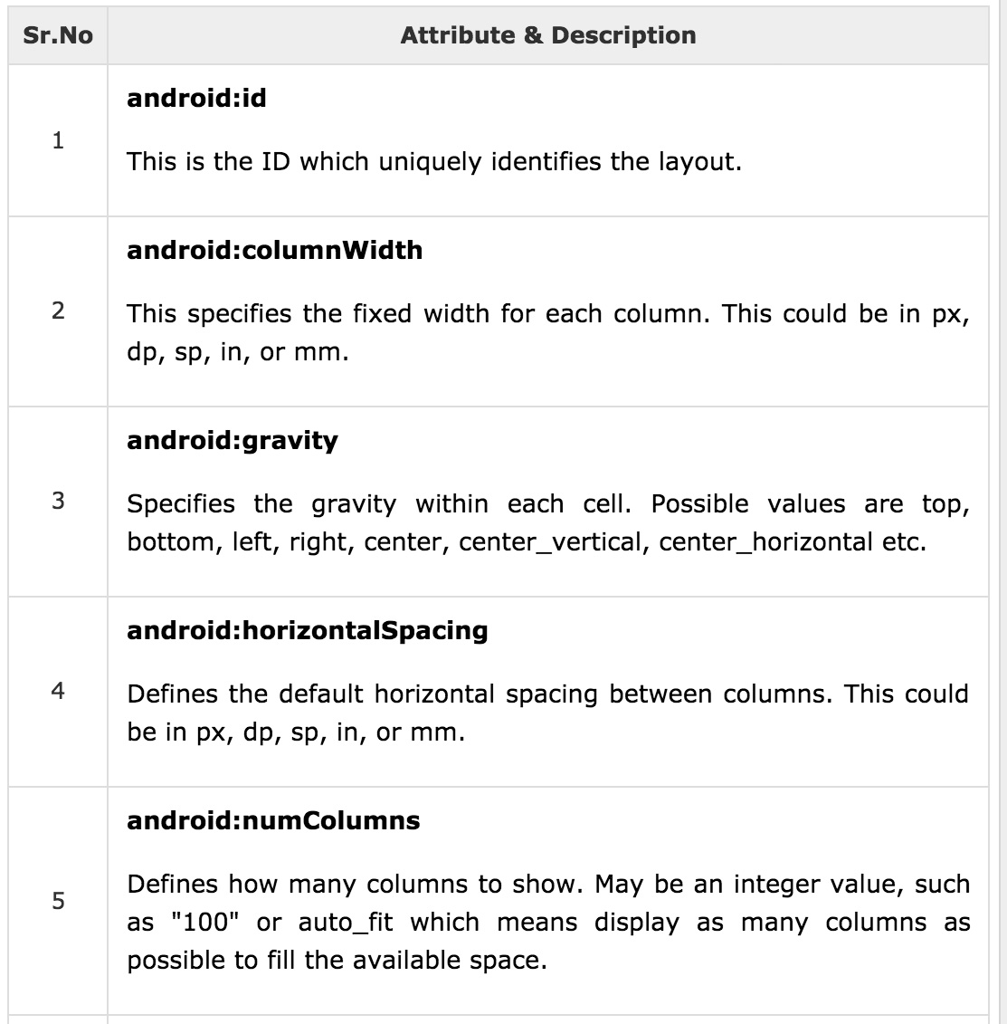
GRIDVIEW ATTRIBUTES

Slide 11
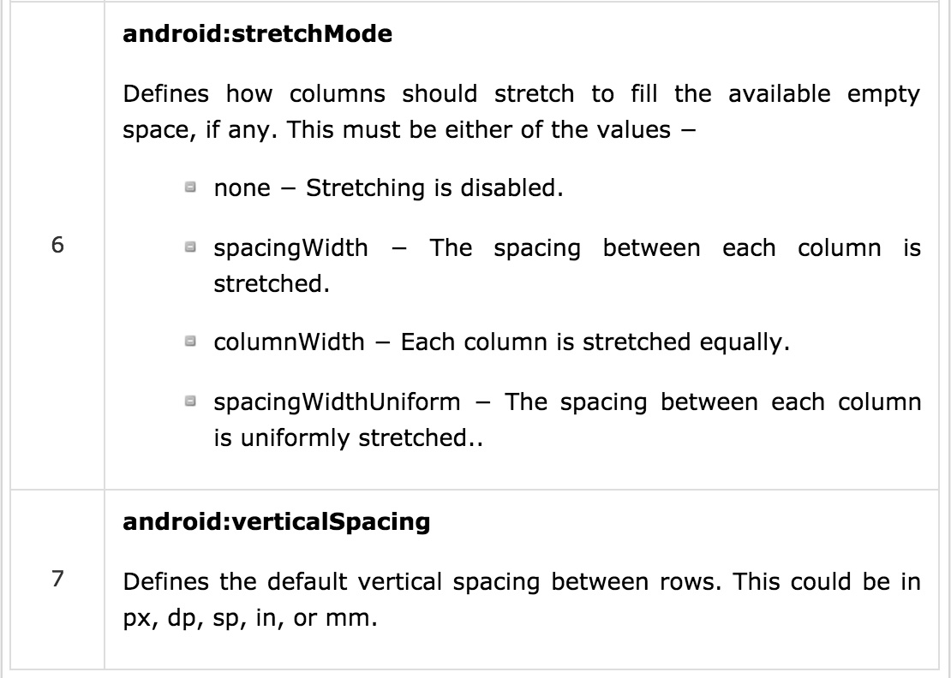
GRIDVIEW ATTRIBUTES

Slide 12
content
What is ListView & GridView?
What is Adapter?
Listview Attributes
GridView Attributes
ArrayAdapter
SimpleCursorAdapter
ListView events
GridView events

Slide 13
ARRAYADAPTER
You can use arrayadapter when your data source is an array.
For ex: you have an array of strings and you want to display in a ListView → Initialize a new ArrayAdapter as follow:
ArrayAdapter adapter = new ArrayAdapter<String>(this, R.layout.ListView, StringArray);
Arguments for this constructor:
First argument: this → application context
Second argument: layout defined in XML file and having TextView for each string in array to display
Final argument: String Array which will be populated in the TextView.
Once you have array adapter created → call setAdapter() on ListView object as follow:
ListView listview = (ListView) findViewById(R.id.listview);
listview.setAdapter(adapter);

Slide 14
content
What is ListView & GridView?
What is Adapter?
Listview Attributes
GridView Attributes
ArrayAdapter
SimpleCursorAdapter
ListView events
GridView events

Slide 15
SIMPLECURSORADAPTER
You can use simplecursoradapter when your data source is a database Cursor.
You must specify a layout to use for each row in the Cursor and which columns in the Cursor should be inserted into which views of the layout
String[] fromColumns = {ContactsContract.Data.DISPLAY_NAME, ContactsContract.CommonDataKinds.Phone.NUMBER};
int[] toViews = {R.id.display_name,R.id.phone_number};
SimpleCursorAdapter adapter = new SimpleCursorAdapter(this, R.layout.person_name_and_number, cursor, fromColumns, toView, 0);
ListView listView = getListView();
listView.setAdapter(adapter);

